Slide 1
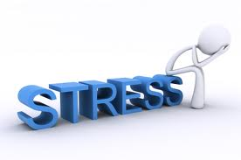
management at work

Slide 2

General Awareness
What is stress?
Type of stress
Individuals
Body origin & body system
Adoption syndrome
Symptoms

Slide 3

What is stress
Stress is the “wear and tear” our minds and
bodies experience as we attempt to cope
with our continually changing environment
Types of stress
External
Internal

Slide 4
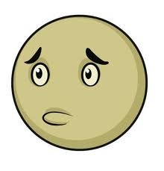

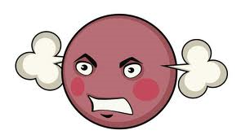
Stress feelings
Worry
Tense
Tired
Frightened
Elated
Depressed
Anxious
Anger

Slide 5
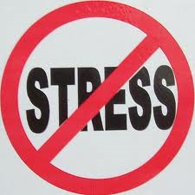
External stressors
Physical Environment
Social Interaction
Organizational
Major Life Events
Daily Hassles

Slide 6
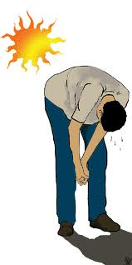
Physical environment
Noise
Bright Lights
Heat
Confined Spaces

Slide 7
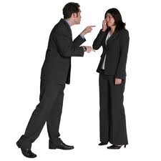
Social interaction
Rudeness
Bossiness
Aggressiveness by others
Bullying

Slide 8
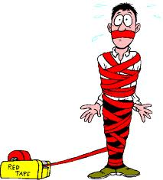
Organizational
Rules
Regulations
“Red - Tape”
Deadline

Slide 9

Major events in life
Birth
Death
Lost job
Promotion
Marital status change

Slide 10
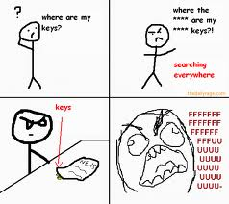
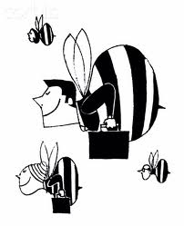
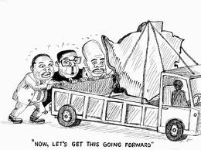
Daily hassles
Misplaced keys
Commuting
Mechanical breakdowns

Slide 11
Internal stressors
Lifestyle choices
Negative self – talk
Mind traps
Personality traits

Slide 12
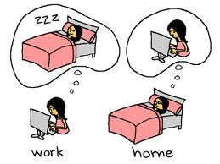
Lifestyle choices
Caffeine
Lack of sleep
Overloaded schedule

Slide 13
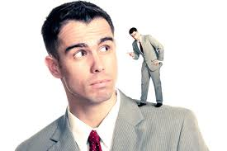
Negative self talk
Pessimistic thinking
Self criticism
Over analysing

Slide 14
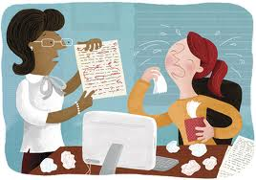
Mind traps
Unrealistic expectations
Taking things personally
All or nothing thinking
Exaggeration
Rigid thinking

Slide 15
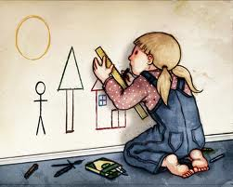
Personality traits
Perfectionists
Workaholic

Slide 16
Kind of stress
Negative
It is a contributory factor in minor conditions, such as headaches, digestive
problems, skin complaints, insomnia and
ulcers.
Excessive, prolonged and unrelieved stress
can have a harmful effect on mental,
physical and spiritual health

Slide 17
Positive
Stress can also have a positive effect,
spurring motivation and awareness,
providing the stimulation to cope with
challenging situations.
Stress also provides the sense of urgency
and alertness needed for survival when
confronting threatening situations.

Slide 18
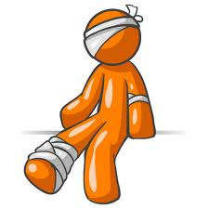
Symptoms of stress
Physical symptoms
Mental symptoms
Behavioral symptoms
Emotional symptom

Slide 19
Physical symptoms
Sleep pattern changes
Fatigue
Digestion changes
Loss of sexual drive
Headaches
Aches and pains
Infections
Indigestion
Dizziness
Fainting
Sweating & trembling
Tingling hands & feet
Breathlessness
Palpitations
Missed heartbeats

Slide 20
Mental symptoms
Lack of concentration
Memory lapses
Difficulty in making decisions
Confusion
Disorientation
Panic attacks

Slide 21
Behavioral symptoms
Appetite changes - too much or too little
Eating disorders - anorexia, bulimia
Increased intake of alcohol & other drugs
Increased smoking
Restlessness
Fidgeting
Nail biting
Hypochondria

Slide 22
Emotional symptoms
Bouts of depression
Impatience
Fits of rage
Tearfulness
Deterioration of personal hygiene and
appearance

Slide 23


Stress awareness
ABC STRATEGY
A = AWARENESS
What causes you stress?
How do you react?

Slide 24

ABC strategy
B = BALANCE
There is a fine line between positive /
negative stress
How much can you cope with before it
becomes negative ?

Slide 25

ABC strategy
C = CONTROL
What can you do to help yourself combat the
negative effects of stress ?

Slide 26

Change your behavior
Be assertive
Get organized
Ventilation
Humor
Diversion and distraction

Slide 27

Equality & basic rights
1) The right to express my feelings
2) The right to express opinions / beliefs
3) The right to say ‘Yes/No’ for yourself
4) Right to change your mind
5) Right to say ‘I don’t understand’
6) Right to be yourself, not acting for the
benefit of others

Slide 28
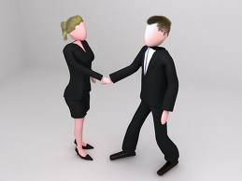
Assertive skills
Establish good eye contact / don’t stare
Stand or sit comfortably - don’t fidget
Talk in a firm, steady voice
Use body language
‘I think’ / ‘I feel’
‘What do you think?’ ‘How do you feel ?’
Concise and to the point

Slide 29

Benefits
Higher self-esteem
Less self-conscious
Less anxious
Manage stress more successfully
Appreciate yourself and others more easily
Feeling of self-control

Slide 30

Get organized
Poor organization is one of the most
common causes of stress. Structured
approaches offer security against ‘out of the
blue’ problems. Prioritising objectives,
duties and activities makes them
manageable and achievable. Don’t overload
your mind. Organisation will help avoid
personal and professional chaos

Slide 31
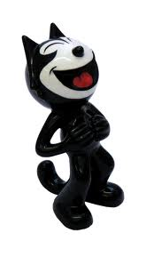
Humor
Good stress – reducer
Applies at home and work
Relieves muscular tension
Improves breathing
Pumps endorphins into the bloodstream -
the body’s natural painkillers

Slide 32
Diversion and Distraction
Take time out
Get away from things that bother you
Doesn’t solve the problem
Reduce stress level
Calm down
Think logically

Slide 33
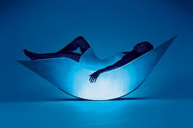
Change your lifestyle
Diet
Smoking & Alcohol
Exercise
Sleep
Leisure
Relaxation

Slide 34


