Slide 1
Personality Development

Slide 2
Good Personality
Attributes of a person with “Good personality”?
Good physique
Pleasing manners
Personal and Professional integrity
Trustworthiness and reliability
Good control over body and mind

Slide 3
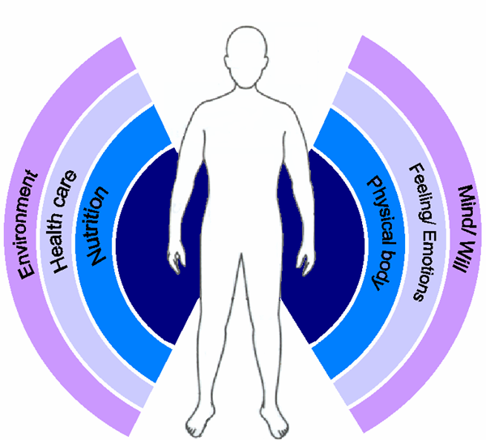
Healthy Body

Slide 4
Healthy Body
Nutrition
Personal Hygiene
Exercising
  Traditional methods (Yoga, Pranayam etc.)
  Modern methods (Gym, aerobics, etc.)
  Walking and jogging
Disciplining of daily routines is a must!
  Mind control is essential for a healthy body.
No junk food!

Slide 5
When is mind unhealthy?
Agitated mind is unhealthy
What agitates human mind?
  Not getting what one desires
  Getting what one dislikes
  Uncontrolled emotions in the mind
Continuous accumulation of such likes and dislikes stresses the mind out.
Stress agitates the mind
Stressed mind is unhealthy

Slide 6
Healthy Mind
Stress-free mind is healthy and calm
Such calm mind can be controlled more easily
De-stressing the mind is needed:
Prevention of accumulation of day-to-day complexes
Clearing the stockpile of stored complexes
HOW?

Slide 7
Cultivating a Healthy Mind
Documented human experience of the past:
  Non-reactive observation of oneself mitigates the strength of these complexes
  Continuous awareness makes this a continuous process: results in clearing the stockpile
Different paths for removal of accumulated complexes:
  Path of service
  Path of intellectual analysis
  Path of devotion
  Path of meditation

Slide 8
Summary
Good Personality arises from a healthy body and healthy mind
Healthy body needs a healthy mind
Healthy mind can be achieved by preventing accumulation of complexes in mind
Non-reactive self-observation de-stresses the mind
This is possible through several paths: paths of service, intellectual analysis, devotion or meditation

Slide 9
Thank You ...

